Slide 1
Simulation of hypersonic flow in reentry like scenarios
Henri Höchter, Matr. Nr.:
Michael Heider Matr. Nr.:
Juli, 20th 2025

Slide 2
Agenda
Theory of hypersonicflows in a reentry situation
OpenFoam native solver
Hy2Foam
Nose radii investigation
Summary

Slide 3
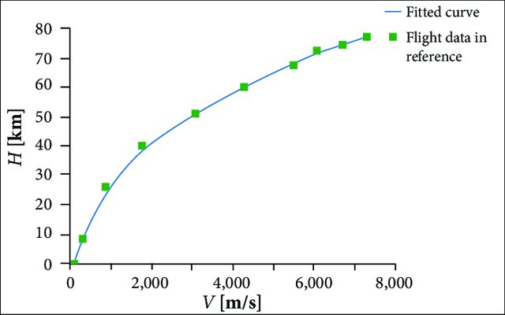

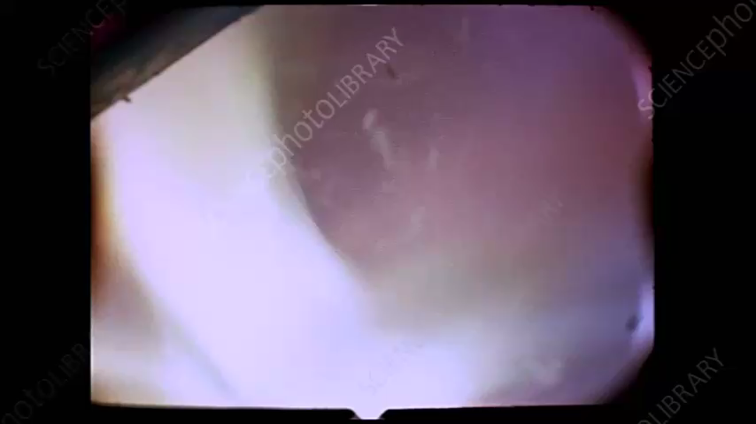
Definition of hypersonic flow in a reentry scenario
Hypersonic flow:
M > 5
Particle temperature:
Heat on surface:
Density vs. height:
100km
Plasma occuring
Highest thermal stress
Density
0km
Notes:
2 min. for this slide
Focus on: 1. hypersonic flows contain a lot of energy!
2. different phenomena in different heights

Slide 4
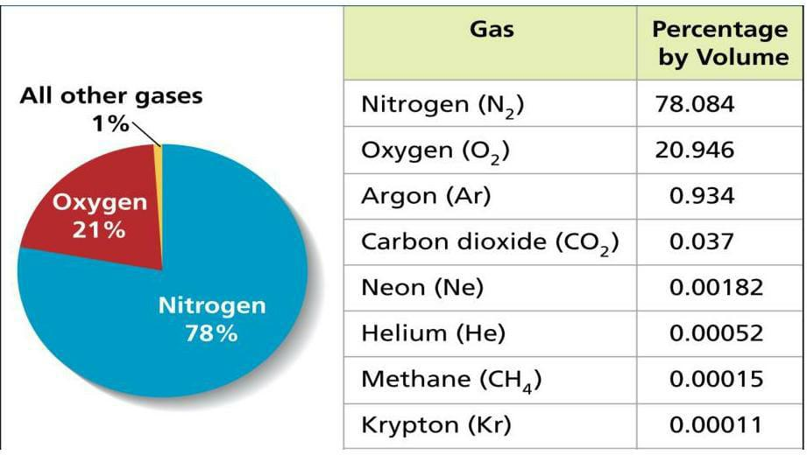
Energy models
N
N
N
N
N
O
N
N
N
N
O
O
N
O
N
O
O
Translational
Vibrational
Electron
Kinetic
Rotational
Electronic
Enthalpy Flux
i = {x,y,z}
s = number of
species
Notes:
2 min. for this slide
Focus on: 1. Energies in hypersonics are complicated
2. different solvers are needed for different stages
Draw an blackboard: definition of translational, rotational and vibrational
Explain: why two temperature model!

Slide 5
Agenda
Theory of hypersonicflows in a reentry situation
OpenFoam native solver
Hy2Foam
Nose radii investigation
Summary

Slide 6
openFoam native solver solution
reactingFoam vs. rhoCentralFoam
whats it supposed to do
why it has problems with reentry
what we done
where we failed
Thumb-cinema of what was simulated
Code Snippet 1 of constants
Code Snippet 2 of system
Code Snippet 3 of error message
Notes:
2 min. for this slide
Focus on: 1. What did we do?
2. Why did we do it that way?

Slide 7
Agenda
Theory of hypersonicflows in a reentry situation
OpenFoam native solver
Hy2Foam
Nose radii investigation
Summary

Slide 8
Agenda
Theory of hypersonicflows in a reentry situation
OpenFoam native solver
Hy2Foam
Nose radii investigation
Summary

Slide 9
Agenda
Theory of hypersonicflows in a reentry situation
OpenFoam native solver
Hy2Foam
Nose radii investigation
Summary

Slide 10
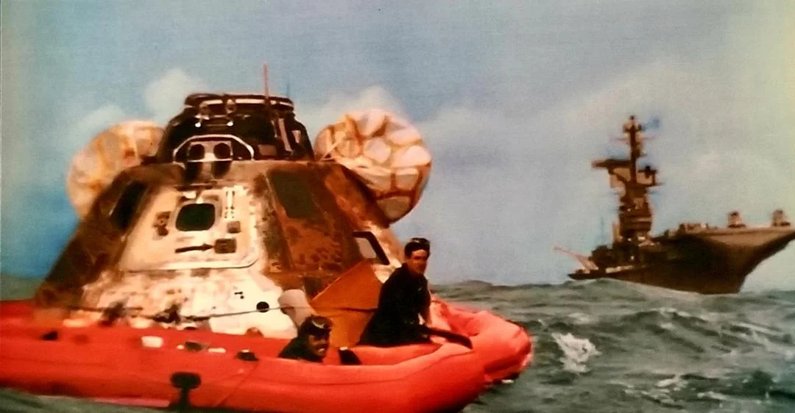
In Summary, simulation of hypersonic flows is complicated!
Why rhoCentralFoam
What was simulated in rhoCentralFoam
What was done for radii investigations
Results of radii investigations

Slide 11
Appendix
Resources:
Space shuttle reentry curve: 21.07.2025 11:10Uhr https://www.researchgate.net/publication/320598271_Aerothermodynamic_Optimization_of_Aerospace_Plane_Airfoil_Leading_Edge/figures
Plasma on apollo capsule: 21.07.2025 11:41Uhr
https://www.sciencephoto.com/media/239615/view/apollo-16-re-entry
Composition of the atmosphere: 21.07.2025 11:46Uhr
https://www.geeksforgeeks.org/social-science/composition-and-structure-of-earth-atmosphere/
Landed reentry capsule: 21.07.2025 12:40Uhr
https://www.scmuseum.org/learn/deeper-dive-series/capturing-history-apollo-11-splashdown

